Slide 1


Big Data Technology – BIA 678
Class 2 – Introduction (Continued)
David Belanger PhD
Senior Research Fellow – Stevens Institute of Technology
dbelange@stevens.edu

Slide 2
Class 2 - Outline
Administrative Stuff:
Formation of teams
Discussion of potential paper topics
Readings coming up
Cloudera, Cloud,, …
Activity #1 – Discussion of Readings
Twitter Paper
McKinsey Paper
Assignment #1 – See Following Slide
Activity #2 – Finish Introduction
Activity #3 – Discussion of Cloudera Downloads

Slide 3
Sources for Class: Module 2 - Scale
Readings | Discussion Leaders
Dean & Ghemawat, “MapReduce:Simplified Data Processing on Large Clusters”, http://static.googleusercontent.com/media/research.google.com/en/us/archive/mapreduce-osdi04.pdf, 2004
Ghemawat, et al, “Google File System”, http://static.googleusercontent.com/media/research.google.com/en/us/archive/gfs-sosp2003.pdf , 2003
Apache MapReduce Tutorial, https://hadoop.apache.org/docs/r1.2.1/mapred_tutorial.html
Notes:
Apache MapReduce Tutorial, https://hadoop.apache.org/docs/r1.2.1/mapred_tutorial.html

Slide 4
Course Information
Course Materials:
There will be a variety of readings for each class.
There is available a training set on Hadoop from Cloudera.
Office Hours: Office Hours: Usually Monday - Wednesday.
Officially Tuesday 2 – 4,
Typically around Monday PM, until Wednesday AM.
Or By Appointment
Office: Babbio 409
Grading Assistant:– Lulu Zhu- On Canvas
Bootcamp for Hadoop & Spark (counts as homework) Feb 23rd and March 2. Given by Jimmy Zheng and Hao Han.
Systems Plan:
Cloudera on all Laptops
Access to a Cluster for Projects
Cluster will contain, at least: Hadoop, Cassandra, Rhadoop, Spark.
Most, but not all, people will end up using Python and Spark

Slide 5
Course Information
Grades:
Team Project (Written & Oral). (40%)
Milestones Throughout the Semester (TBA).
Oral Presentations for each team in last class (or if necessary last 2 classes).
Teams can be 1 – 4 people.
A short, ½ page, proposal will be due at Class 6. Proposed data and goals.
Students will form their teams, but team membership should be decided by Class 3. In some cases minor changes can occur later. Fill out the equivalent of slide 9 for your team by class 3. If changes, submit new slides.
Class Leadership and Homework. (25%)
In each class meeting, members of the class will be assigned readings on which they will lead discussion. Everyone should read all readings and be prepared to discuss them. Students will be randomly selected to report on readings.
Each student will write and submit a short review of readings, about ½ page, each week.
About every 2 weeks, programming homework assignments will be given.
Term Papers. (35%)
One term paper, of about 5 – 8 pages, on a subject of the student’s choice.
Paper due the first week in April (Class 9), Penalties if Later.
Proposed topic, with short abstract, is due in Class 5.
Late Policy: For reading reports, papers later than the end of the week due will be penalized 50%.

Slide 6
Course Information
Career Fair – November.
Each November there is a BIA Career Fair.
You should consider submitting your project to the Career Fair. It will mean finishing a poster for the project a week or two early, but is well worth it for meeting corporate folks.
In any case, you should consider making your project suitable for placement on your web site.

Slide 7
Team Pictures Teams 1 – 4 Folks (A picture of you, and your name; Optional: Your Major, Home City)
DGB Williams F1 Oxford UK
DGB Chief Scientist
DGB Emmy Las Vegas
Daughter’s Wedding Reception
DGB WWW2008 Keynote, Beijing

Slide 8
Term Paper Topics Spring 2018
Title
Real Time Stream Processing, Analysis and Architecture
BIG DATA IN TELECOM SECTOR
Big Data in Human Resource
Recommender Systems and Big Data
Big Data and Blockchain Make a Powerful Couple for New Trend
Evolution in Master Data Management (MDM) to Address the Needs of the Big Data Revolution
Data Visualization in The Era of Big Data
Big Data in Banking & Finance

Slide 9
Term Paper Topics Spring 2018 (Fall 2018 on CANVAS)
A Survey of Music Recommender Systems
Heart Failure Prediction based on Multi-Layer Perceptron Classifier
Data Mining Technology and Its Application in E-commerce
BIG DATA IN MANUFACTURING
Big Data In Baseball
Time series analysis using the hybrid of artificial neural network and Autoregressive integrated moving average (ARIMA) model
HEDGE FUNDS AND BIG DATA
BIG DATA IN FOOD INDUSTRY
Big Data and Machine Learning
Big Data in Deep Learning: How Big data is empowering AI and Machine Learning
Data Migration from Relational Database to NoSQL Database
Impact of Big Data on Video Games
Accelerating Data Management Systems with Machine Learning
Big Data in NBA
A Survey of Big Data in Sports
DATA VISUALIZATION IN THE WORLD OF BIG DATA
An Overview of Current RNA Sequencing Methods
Big Data Application: Medical Care Science
A Survey on Web Usage Mining

Slide 10
Project Grading
Grades based on (range 0 – 5, average 3):
Presentation & Paper:
Topic
Knowledge
Depth
Clarity
Content
Conclusion
Plagiarism will result in very severe penalties
CAL will provide detailed instructions on writing papers.
https://owl.english.purdue.edu/owl/resource/658/1/

Slide 11
Class Structure
In general, the structure of each class will be:
Discussion of assigned readings
Students randomly selected to report on readings
Lecture
Technology Discussion (i.e. tools)
Project Discussion

Slide 12
KDNuggets A Good List of Free Data Sources and A Good Source for Interesting Data Science Information
https://www.kdnuggets.com/2017/12/big-data-free-sources.html
Kaggle is also often a source of very good data.

Slide 13
Course Topics
Modules | Purpose
Introduction | Overview of BD Technologies and Issues
Core Technologies for Distribution | Map/Reduce, Hadoop, HDFS, Spark – Dataframes, Compression
Data Base Management | CAP, NoSQL, Column Store, Hbase, Xquery, …
Data Stream Management | IoT, DSMS, Analytics on Streams
Big Data Analytics | Impact of Scale, Recommenders, Ensemble, Variety
Visualization | Effects of scale
Data Governance | Policy, Process, Practice
Meta Issues – Privacy, Security, Deployment, OA&M | GDPR, Verizon DBIR, Privacy Policies, Operations
Applications
Project Presentations

Slide 14
What’s Different? What! - Data

Slide 15
Some Things That Make a Difference DATA
Change | Classical | Big Data | Example
Granularity | Transactional or Aggregate | Elementary, Personalized | Web Transaction vs Click Stream
Signal Strength | Strong | Σ Weak | Google Trends
Latency | Transactional or Long | Streams and Real time | Location
Location | ZIP Code, Area Code, Nxx, | GPS, Lat/Long | Location Based Systems
Structure | Relational | Structured, SemiStructured, Unstructured, Graph | Social Networks, Speech + Video Mining
Sources of Data | Operational, Organic | Operational + Crowd + Sensors + IoT + Manufactured | Dallas Museum of Art, Fitbit,
Data Integration @ Scale | Hard, Join, Structured | Structured & Unstructured, Large Scale, Still not easy
Streaming Data | Possible, using ad-hoc communication networking | Common, and with IoT to become much more common | IoT, High Freq Trading, Medical, etc.

Slide 16
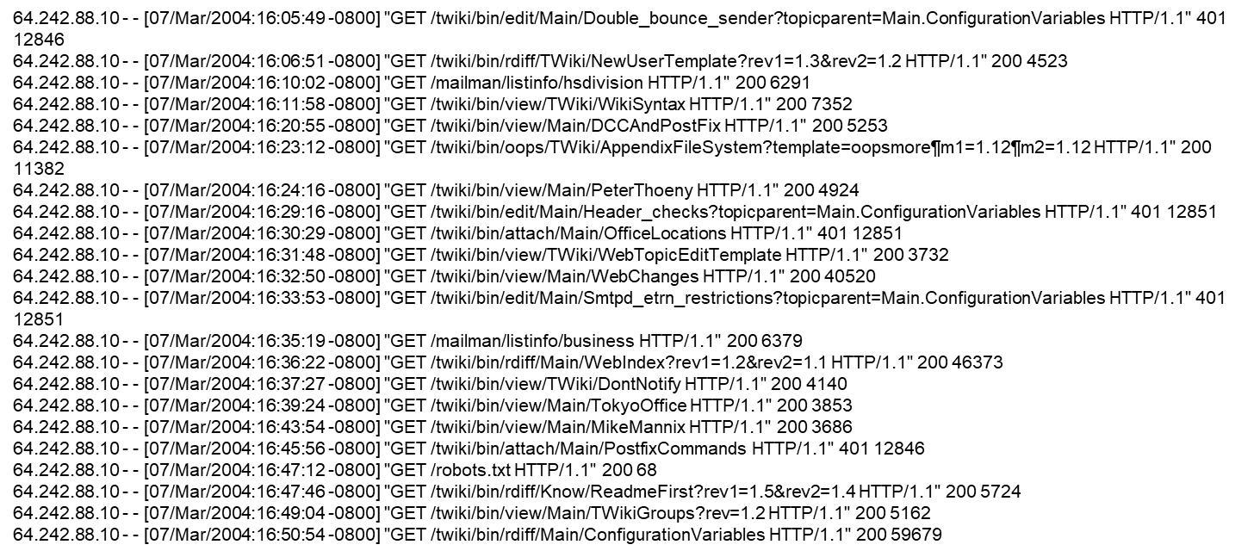
Example of Data
Apache Web-Log Data

Slide 17
What’s Different? How! - Technology

Slide 18
Some Things That Make a Difference Technology
Change | Classical | Big Data | Example
Computing Platforms | Large Symmetric Multiprocessors, expensive | Parallelism using commodity hardware | Cost reduced by x10, Cloud
Software Platforms | RDBMS, Analytic Software, Viz Software | Oriented to massive parallelism, Often Open Source | Map/Reduce, Hadoop, Storm,..
Data Base Systems | RDBMS, Transactional | Often Column Oriented, Availability Oriented | Hbase, MongoDB, Cassandra, ….
Visualization | Static, Aggregate, Dashboards | Interactive, Drill Down | Swift
Streams vs Warehouses | Warehouse: Size: N View: Query Latency: High | Streams: Size: ∞ View: Window Latency: Low | Fraud, High Frequency Trading, Targeted Marketing

Slide 19
Map Reduce Patent
Google granted US Patent 7,650,331, January 2010
System and method for efficient large-scale data processing A large-scale data processing system and method includes one or more application-independent map modules configured to read input data and to apply at least one application-specific map operation to the input data to produce intermediate data values, wherein the map operation is automatically parallelized across multiple processors in the parallel processing environment. A plurality of intermediate data structures are used to store the intermediate data values. One or more application-independent reduce modules are configured to retrieve the intermediate data values and to apply at least one application-specific reduce operation to the intermediate data values to provide output data.

Slide 20
Back to Basics Definition

Slide 21
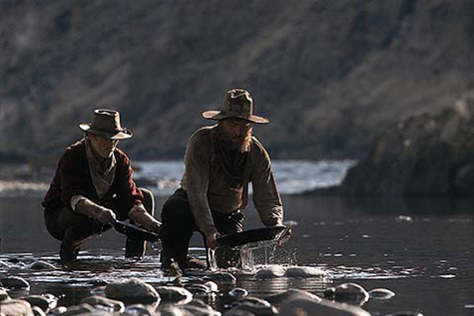
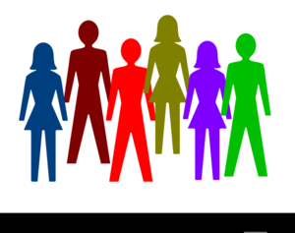
Big Data What?, How?, Why?
WHY:
APPLICATIONS
“Valuable capabilities that were formerly too difficult, costly, or simply not possible.”
Why
What
Big Data
How
WHAT:
DATA
VOLUME
VELOCITY
VARIETY
TECHNOLOGY
DISTRIBUTION
D[BS]MGT
MACHINE LEARING ++
Lots of Data is not the same as Big Data
HOW:
GOVERNANCE, ORGANIZATION
PEOPLE
...
Picture Source:
https://www.theguardian.com/science/2014/feb/12/nuclear-fusion-breakthrough-green-energy-source

Slide 22
Some Things That Make a Difference
Individual Level Granularity
Weak vs Strong Signals http://www.google.org/flutrends/
Time – e.g. Real Time (location)
Population vs Sample (use customer service example)
Transparency – i.e. cloud and web (Marketing and Advertising)
Prediction (Slipper)
Learning (e.g. google translate, recommender)
Behavioral Data

Slide 23
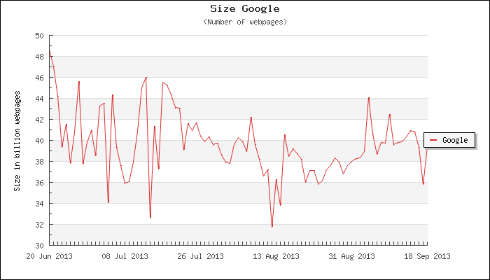
Examples of Big Data - Text Search
V o l u m e
V a r i e t y
<!DOCTYPE HTML PUBLIC "-//W3C//DTD HTML 4.01//EN" "http://www.w3.org/TR/html4/strict.dtd"> <HTML> <HEAD> <TITLE>My first HTML document</TITLE> </HEAD> <BODY> <P>Hello world! </BODY> </HTML>
<!DOCTYPE HTML PUBLIC "-//W3C//DTD HTML 4.01//EN" "http://www.w3.org/TR/html4/strict.dtd"> <HTML> <HEAD> <TITLE>My first HTML document</TITLE> </HEAD> <BODY> <P>Hello world! </BODY> </HTML>
http://www.w3.org/TR/REC-html40/struct/global.html
http://www.worldwidewebsize.com/

Slide 24
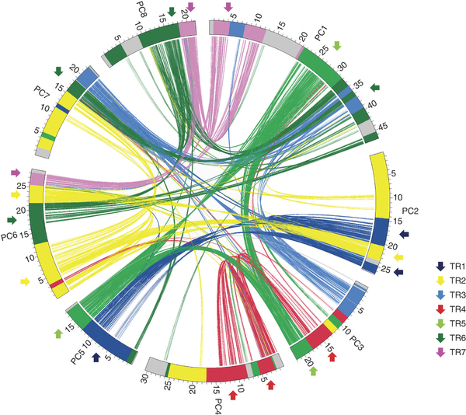
Examples of Big Data - Science Peach Genome
V e l o c i t y
V o l u m e
V a r i e t y
http://www.nature.com/ng/journal/v45/n5/full/ng.2586.html

Slide 25
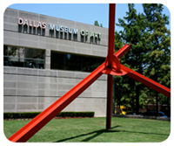
Big Data Creating Sources of Data
(e.g. Dallas Art Museum)
Classical Techniques
Membership in Museum, Monitoring customers.
Big Data Techniques
Search for ways to create new, useful, behavioral data, and to gather open data sources for integration.

Slide 26
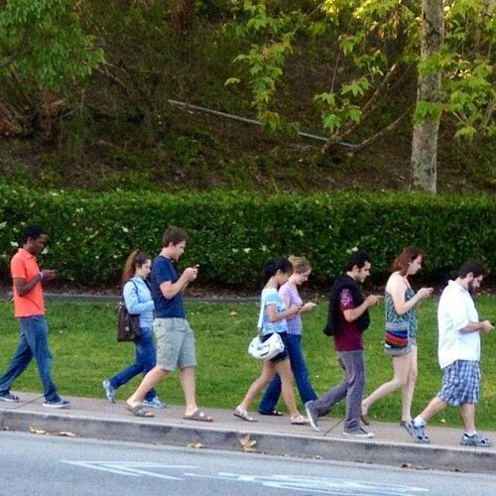
https://grooverpr.files.wordpress.com/2013/08/group-of-people-walking-and-texting.jpg
Crowd
A Billion or So People as Source and Consumer of Data – Anytime, Anyplace.
Crowd = People & Devices (Smartphones, Sensors, Cameras, …) + Networks + Services + Data + Analytics
Notes:
Reference*
C. Aggarwal, 2013, Managing and Mining Sensor Data

Slide 27
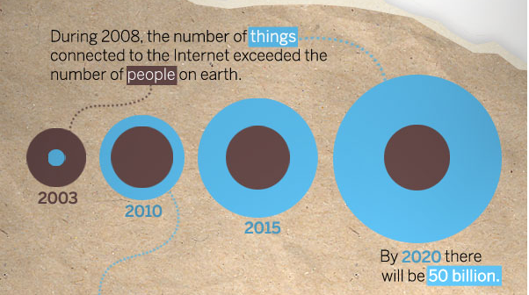
The Next “Crowd” Network connected Things and Devices
Image courtesy: CISCO

Slide 28
The next “crowd” - Objects Devices That Can Be Networked & IP Addressable How can we best exploit the billions of devices, many mobile, intelligent, and video enabled as computing, sensing, and communications platforms?
Machinery
Home Appliances
Vehicles & Handheld Devices – “Crowd”
Pallets and Cases
Computers
b
Consumer Items & Sensors
10¹⁰
10⁹
10¹¹
10¹²
10¹³
10¹⁴
Invisible Computing - Will Far outnumber current IT Devices and People
Home Appliances
Consumer Items
Pallets and Cases
Machinery
Vehicles and Handheld Devices
Sensors – Machine to Machine Internet
Integration
Communications
Entertainment
Page 28
Notes:
28
The Internet, or Cyber space, is multidimensional and provides access to and from numerous environments through interconnections between various networks around the world.
The threats to AT&T’s portion of cyber space comes in many flavors and sizes; from expert hackers trying to steal credit card information to high school hacker wanna bees who are trying to show that they can get into something perceived as impenetrable. Inappropriate access and theft of information can both have significant economic and political impact on a company or a government. This threat is the threat without.
Another threat is the threat from within or the insider threat. This threat comes from an authorized user of the network, or the cyber space, and represents its own set of difficulties. Insider threats can be an administrator, or user, who hits a wrong key by mistake to industrial spies and disgruntled employees trying to take critical information or destroy key systems before walking out of the door forever.
The data is compelling and we know the data is seriously incomplete. But its completeness is growing every year. REASON: The cost of the threat is starting to equal, or exceed, the cost of the defense.

Slide 29
At the end of the day, Big Data is about taking advantage of scale rather than letting scale take advantage of you.
http://www.google.com/trends/explore#q=big%20data&cmpt=q
http://www.google.com/trends/explore#q=data%20scientist&cmpt=q
http://www.google.com/trends/explore#q=internet%20of%20things

Slide 30
Some Things That Make a Difference Applications
Change | Classical | Big Data | Example
Granularity | Transactional or Aggregate | Atomic, Personalized | Individual’s location at a specific time
Rare Events | Sample Based | Population, Signatures, Classification | Fraud, Security, Social Location
Broad Search | Indexed Retrieval, Flat Files | Structured and Unstructured data | Search Engines
Relationships | Customized | Graphs and (social) Networks | Recommender systems, CoI
Analytics at Scale | Sample | Population | Call Detail, Call Center
Personalized Traits | Survey based | Behavioral | Signatures, Targeted Marketing
Process Control | Silo’ed | End to End, Feedback Control | Virtual Integration
Recommendations, Learning | Rules | ML, Collaborative, Relationship based | Translation, Recommenders
Transparency | Within Silo | Across Processes | Provisioning
Prediction | Limited, Aggregate | Real time, Specific | Slipper
Control | Customized, Rule Based | Learning Based | Driverless Cars

Slide 31
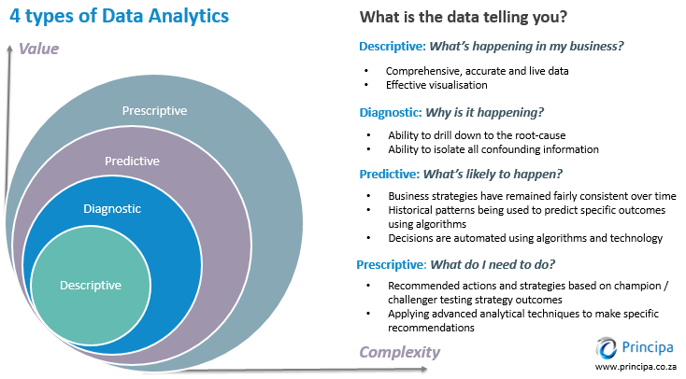
http://www.kdnuggets.com/2017/07/4-types-data-analytics.html

Slide 32
Challenge: Getting More Value from Data Micro View 9,570,000,000,000,000,000,000 Bytes**
Decision Support
Customer* Experience
Operations:
Market
Network
Services
Data In Flight
Efficient, Reliable,
Secure Data
Transportb
Managing Risk:
Security
Fraud
Compliance
Hundreds of Data Sources
Volume
Velocity
Variability
Information Visualization:
The most effective
ways to deliver
Information & Alerts
to decision makers?
Data Analysis:
Industry leading
Information Mining
Technology including
RT
CS & Data Management:
Storage and
processing architectures
That operate at scale,
and in real time
Process Control:
Provisioning
Managed Services
Forecasting & Planning
Vertical Services:
Medical
Smart Grid
Hospitality
** http://hmi.ucsd.edu/howmuchinfo_news.php
* Customer Specific Data is anonymized or aggregated.

Slide 33
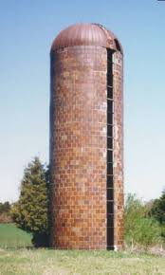
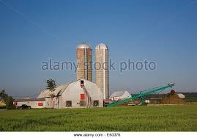
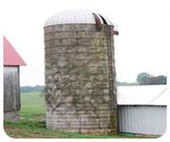
Big Data Understanding, Controlling, & Optimizing Business Processes (Transparency/e.g. Supply Chain, Provisioning, Fullfillment)
Classical Techniques
Operational data typically contained in highly optimized silos with little horizontal analysis
Big Data Techniques
Individual threads of complete process activities for each entry, with analytics and repair automated.
P1
P2
P3
Virtual
Integration
DGB 5/2013

Slide 34
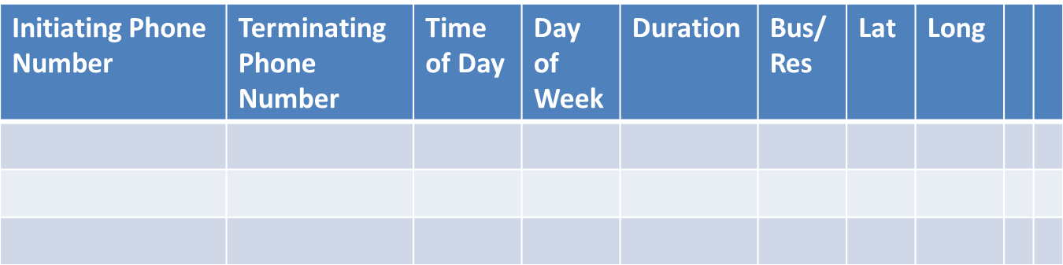
Big Data Applications Detecting Rare Events (e.g. Fraud/Security)
Classical Techniques
For each event, compare the results to a threshold or range, and alert/alarm if outside that value.
Big Data Techniques
For each event, compare to a model for that specific individual, and alarm/alert based on classification.

Slide 35

Big Data Personalized Traits For example: Ad Servers
Classical Techniques
Targeting typically uses aggregate, demographic data.
Big Data Techniques
Individual analysis using behavioral data and at very high speed.

Slide 36
Big Data Relationship Analysis For example: Marketing (Targeted/Viral/Recommenders)
Classical Techniques
If done, expensive and using human simultaneous translators.
Big Data Techniques
Using huge sets of translated corpa of text, matching with reasonable accuracy in near real time.
Watson, come here, I want you
translate.google.com
Native
沃森，來到這裡，我要你
沃森，过来，我需要你。

Slide 37
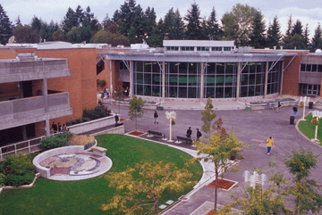
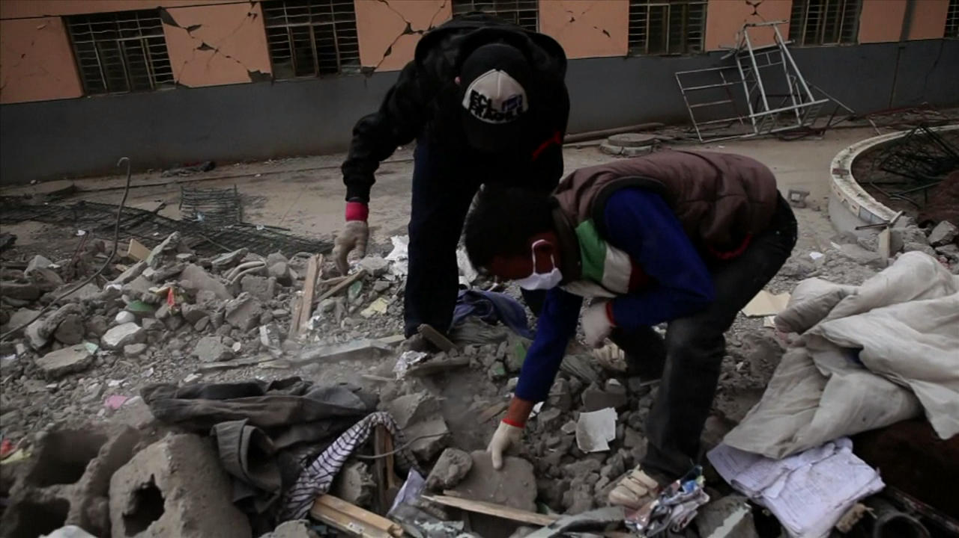

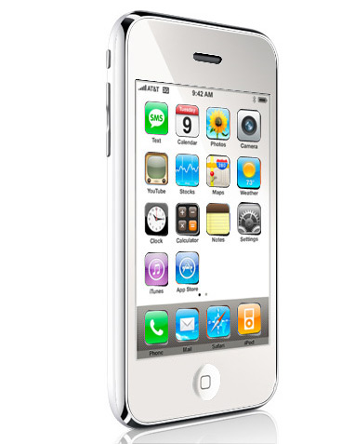
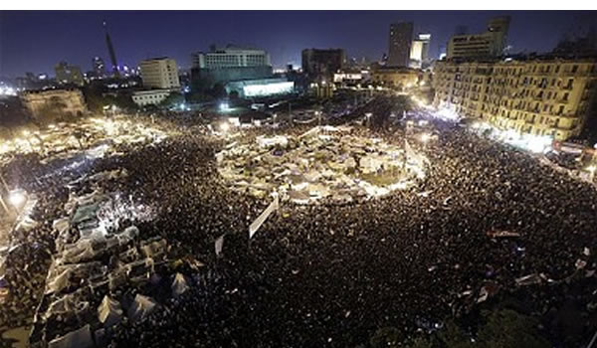
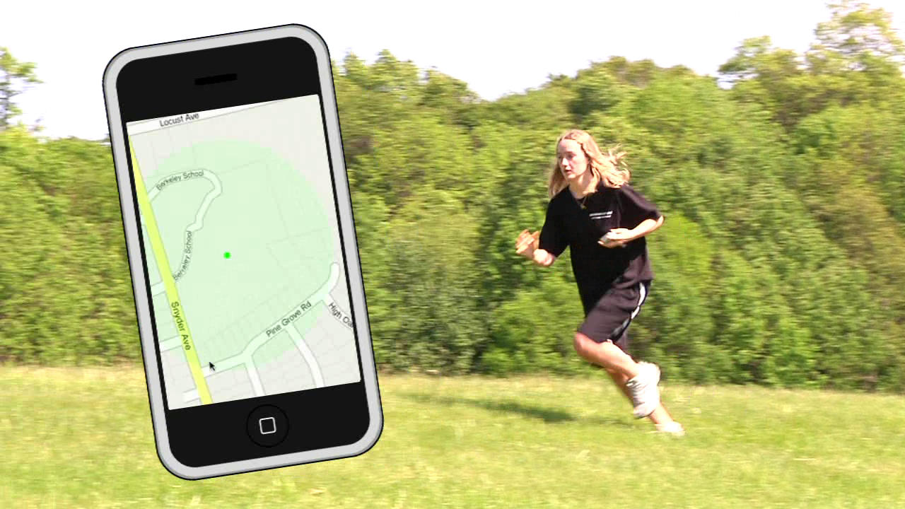






Big Data Location Based Applications For example: Marketing, Advertising, Social Networking, Alerting, Gaming
Classical Techniques
Very difficult to obtain up to data location data.
Big Data Techniques
Within constraints of privacy rules, one of the most powerful types of applications.
Safety, Gaming
Location Based Services

Slide 38
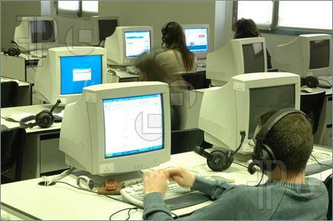
Big Data Call Center Reporting
Classical Techniques
Call service agent records details of a very small (e.g. 1%) sample of calls, or records audio of a small sample for others to listen.
Big Data Techniques
All of the calls are recorded, translated from speech to text and analyzed for reports (e.g. daily updates of customer sentiment.)
http://www.featurepics.com/online/Call-Center-Photos214626.aspx
DGB 5/2013

Slide 39
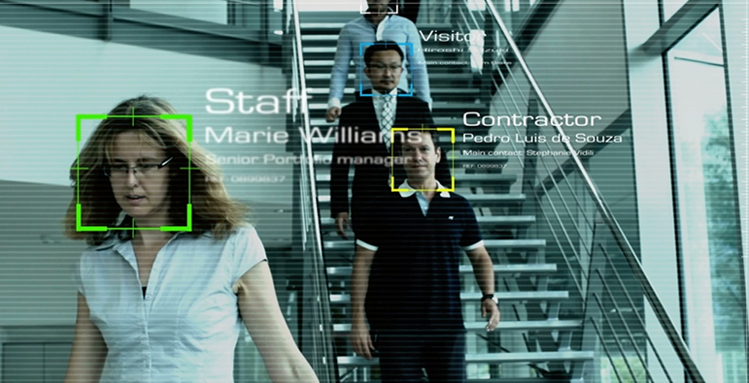

Big Data Image/Video Face (and Object) Recognition
Classical Techniques
Manual and prohibitive in terms of time and effort.
Big Data Techniques
Increasingly automatable using machine learning techniques.
http://se.nec.com/en_SE/global/solutions/safety/face_recognition/index.html
DGB 5/2013

Slide 40
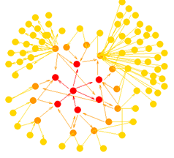
Big Data Relationship Analysis For example: Marketing (Targeted/Viral/Recommenders)
Classical Techniques
Analyze each node (individual) and reach conclusions based on that information. O(n).
Big Data Techniques
For each event, compare to a model based on relationships of that individual, and alarm/alert on that basis. O(n² ) or much larger based on number of generations.

Slide 41
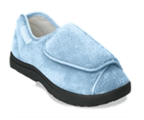
Examples of Big Data Applications Prediction
http://restaurantsmsmarketing.com/mobile-coupons/

Slide 42

Examples of Big Data Applications Understanding & Targeting Customers
http://restaurantsmsmarketing.com/mobile-coupons/

Slide 43
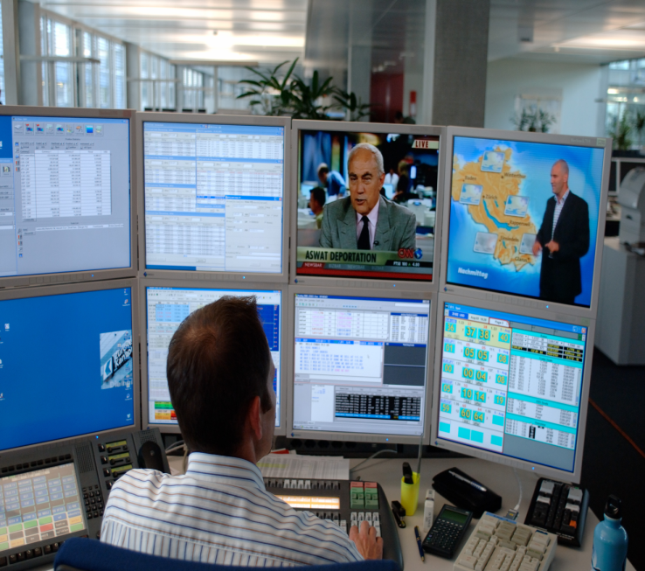
Examples of Big Data Applications High Frequency (Algorithmic) Finance
http://www.weytec.com/en/about-us/news/press-media/

Slide 44

Examples of Big Data Applications Fine Granularity
http://restaurantsmsmarketing.com/mobile-coupons/

Slide 45
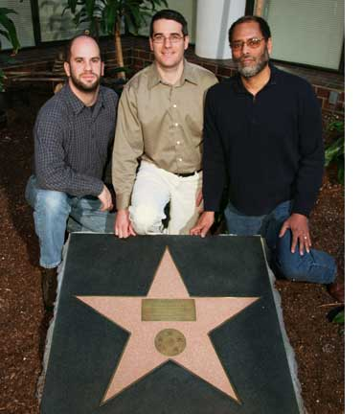
Examples of Big Data Applications Relationships, Recommendations
http://restaurantsmsmarketing.com/mobile-coupons/

Slide 46
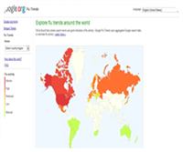
Examples of Big Data Applications Signal Strength
http://restaurantsmsmarketing.com/mobile-coupons/

Slide 47
Some Things That Make a Difference Technology
Change | Classical | Big Data | Example
Computing Platforms | Large Symmetric Multiprocessors, expensive | Parallelism using commodity hardware | Cost reduced by x10, Cloud
Software Platforms | RDBMS, Analytic Software, Viz Software | Oriented to massive parallelism, Often Open Source | Map/Reduce, Hadoop, Spark,,..
Data Base Systems | RDBMS, Transactional | Often Column Oriented, Availability Oriented | Hbase, MongoDB, Cassandra, ….
Visualization | Static, Aggregate, Dashboards | Interactive, Drill Down | Swift
Streams vs Warehouses | Warehouse: Size: N View: Query Latency: High | Streams: Size: ∞ View: Window Latency: Low | Fraud, High Frequency Trading, Targeted Marketing

Slide 48
DBMS Theorem
Brewer’s CAP Theorem:
Consistency
Availability
Partition
Choose 2
Partition
Availability
Consistency

Slide 49
DBMS Examples (Source: Cassandra – The definitive guide, Eben Hewitt, O’Reilly, 2011)
Hbase
Cassandra
Et. al.
Partition
Google Bigtable, Hbase, MongoDB, …
Cassandra, CouchDB, Riak,…
Availability
Consistency
Relational: Oracle, MySQL, SQLServer, DB2, …

Slide 50
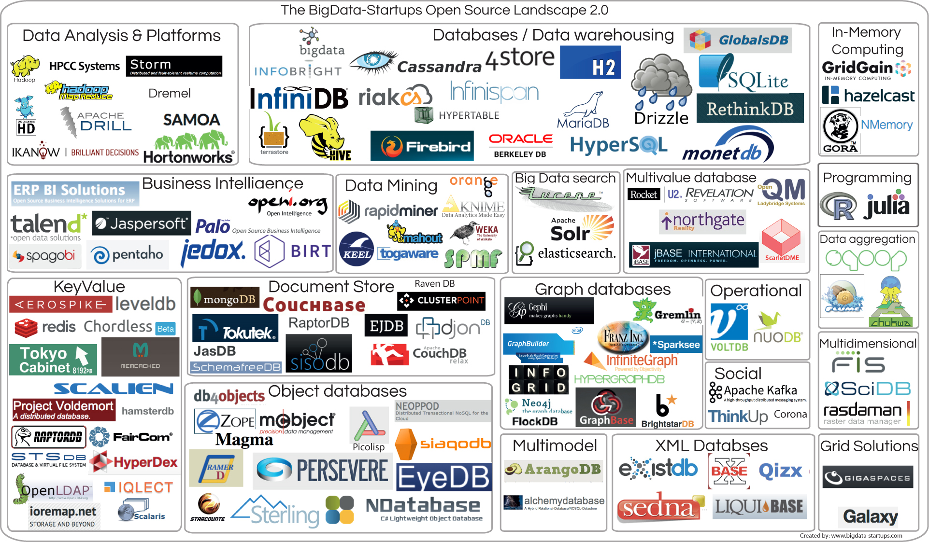
What Got Us Here: Technology Startups/Open Source Landscape
Source: http://www.bigdata-startups.com/open-source-tools/

Slide 51
Is it Real?
CrunchAnalytics provides an answer based on data from CrunchBase, showing us where VCs are placing their biggest bets:
Cloudera (5 rounds) $141 million Apache Hadoop-based software, services and training
MuSigma (1) 133 Data-Science-as-a-Service
Opera Solutions (1) 84 Data-Science-as-a-Service
10gen (6) 73.4 MongoDB (open-source, document database)
Gauvus (3) 70 Big data analytics solutions
ParAccel (3) 64 Analytic platform
Talend (5) 61.6 Application and business process integration platform
GoodData (5) 53.5 Cloud-based platform and big data apps
DataXu (3) 45.8 Digital marketing software
DataStax (4) 38.7 Apache Cassandra-based big data platform
The 40 startups included in the CrunchAnalytics database have raised about $1.2 billion in venture capital.
Source: http://www.forbes.com/sites/gilpress/2013/03/18/top-10-most-funded-big-data-startups/
Notes:
http://www.forbes.com/sites/gilpress/2013/03/18/top-10-most-funded-big-data-startups/

Slide 52
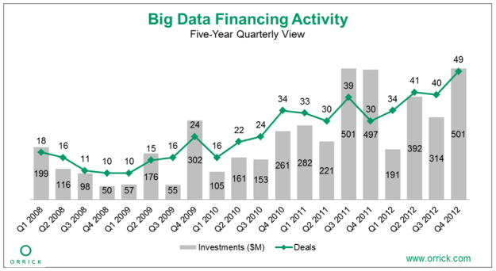
Investment in Big DataCompanies in the Big Data industry have received $4.9 billion in funding since 2008, with the bulk of financing in 2011 and 2012.
Investment in Big Data
Source: http://www.kdnuggets.com/2013/03/top-big-data-vc-investors.html

Slide 53
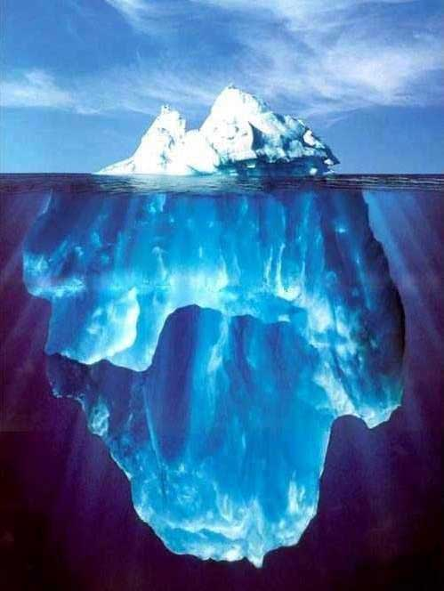
A More Complete Picture
Data
Management
Visualization
Applications
Data Analysis
Incubation
Data Governance – Policy, Process
Data Security
Autonomic Systems
Sandbox
Privacy
Integrity
OA&M
Semantics
Software
Framing Questions
Sustainability
Distribution & Ownership
of Results

Slide 54
Big Data in a Programmable World
Internet of Things / Sensors, Ad Hoc Networks (2010 -)
Mobility (Anywhere, Anytime),Video - Internet of People (2000 -)
Internet + Web + BB Access (1990s)
Transaction Systems (1980-)
Programmable World (2010 -)
Integration
Information
Entertainment
Communications
Notes:
Programmable World: Bill Wasik, Wired , June 2013

Slide 55
Organizing for Innovation - Getting Started
Then | Now
Classical research or exploratory development teams create new products, often in large teams with significant timelines. Careful attention is paid to decision gates to prevent runaway costs. Due to costs, decisions often top down. | Small, elite teams create prototypes of potential products quickly, trial the prototypes, and, when successful, present for funding to go to market. Go to trial, very quick. Classical research provides technology base to prototyping teams, and partners with them.
Innovation Laboratory - InfoLab
Data
New Applications
New Technologies
Effective Organization of Innovation
Subject Matter Expertise

Slide 56

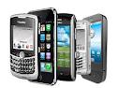
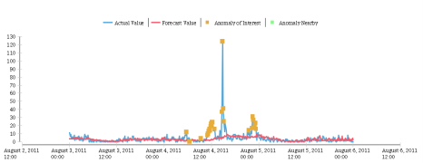
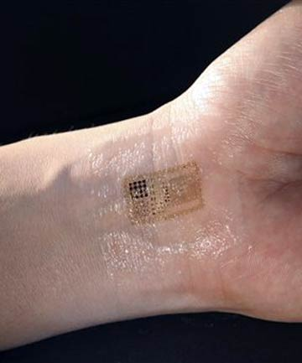
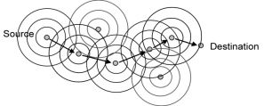
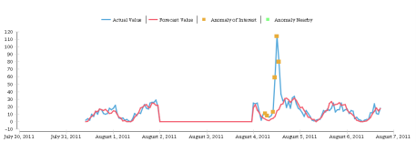
Diversity of Sources – Crowd
Then | Now
Sources of large databases are largely from transactional systems such as credit card swipe, ATM, Financial Markets, or engineered systems such as communication networks , as well as science. | Sources range from individual contributors, to sensors, to networks. The WWW and Mobile Smartphones have turned consumption and generation of data into an always on, anywhere activity. Including video.
Personal Environment Sensors
Health – Vital Signs
Ad Hoc Sensor Networks
Image Source Page: http://modernseoul.wordpress.com/2011/09/07/follow-us-on-twitter-and-like-us-on-facebook/
Image Source Page: http://www.clubic.com/article-277406-5-test-htc-touch-diamond-3g-gps-ecran-vga-wm6-touchflo-3d.html

Slide 57
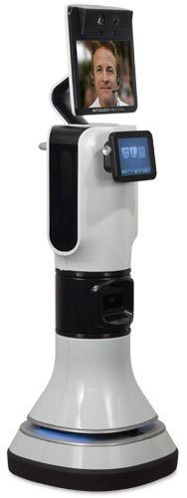
Applications
Source: http://www.informationweek.com/healthcare/mobile-wireless/remote-patient-monitoring-9-promising-te/240159160

Slide 58
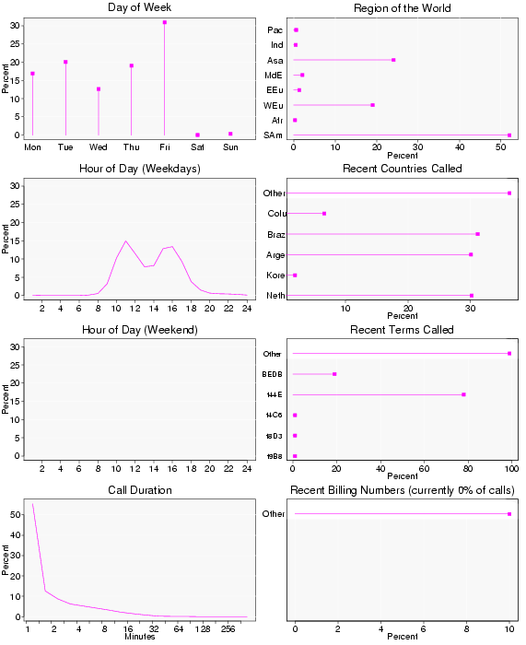
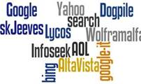
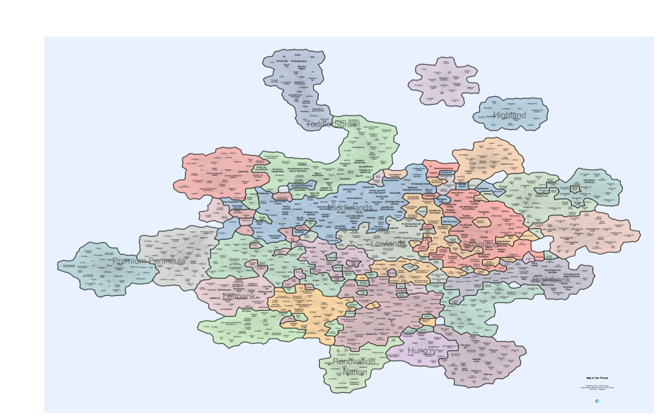
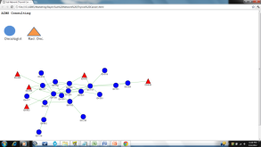
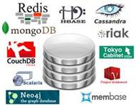
Applications of Big Data
Application Type
Service Oriented Retrieval, Individual Precision, Sparse Data
Paths, Graphs, Relationships
Diversity of Sources
Real Time, Predictive, Data in Flight
Driving Technology

Slide 59



Sparse Targets & Individual Precision
Then | Now
Precision for many measurements, and most targets, are aggregate. Sampling is often used. Accessing a dataset which is a small subset of a huge dataset is difficult, especially for unstructured data. Surveys used for customer experience. | Analysis is of individual events, and measured against individual metrics. Map/Reduce useful for finding relatively small subsets of very large datasets. Customer behavior/results can be used for customer experience.
Search
Misuse
Fraud
Customer Experience
photoblog.nbcnews.com
At&t Labs - Research

Slide 60

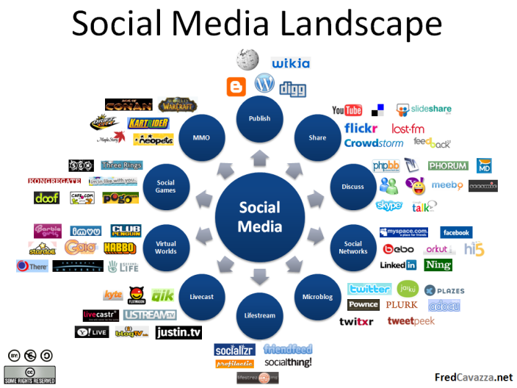
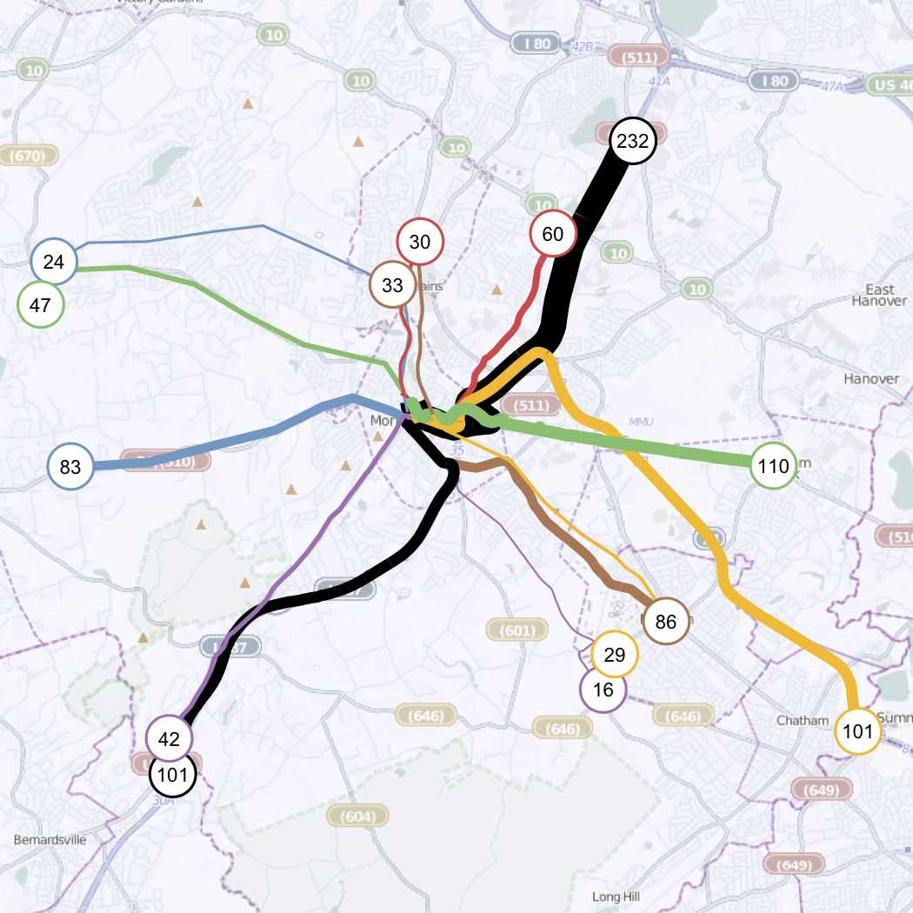

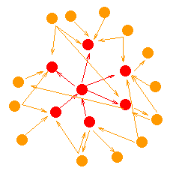

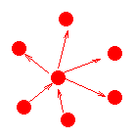
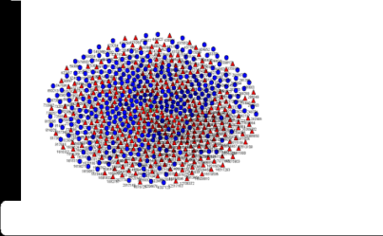
Paths, Graphs, & Relationships
Then | Now
Most analysis and visualization done on graphs is relatively small scale, and seldom interactive. | Networks, including explicit, implicit, and inferred, are analyzed and visualized at very large scale.

Slide 61
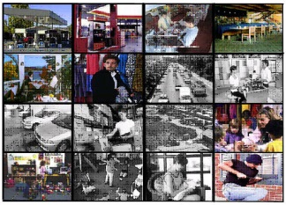
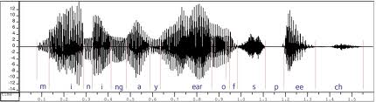
Diversity of Data Types - Variety
Then | Now
Most large data sets are either combinations of alphanumeric fields, or text. | Data types range from the traditional, structured alpha-numic fields, to semi-structured (e.g. Web), to unstructured (text, speech, video, image). All of these, and mixtures of them, are analyzed at scale.
Vodeo/Image Mining
Personal Environment Sensors
Speech Mining
Customer Experience
Customer Interaction Record
www.phon.ox.ac.uk

Slide 62
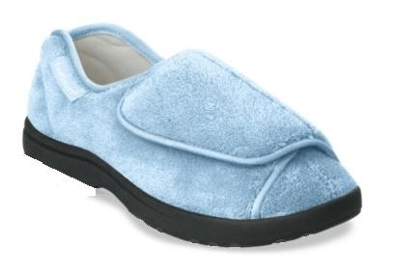
Data in Flight
Then | Now
Real time systems are custom engineered and controlled, typically with relatively small data in flight. Data communications expensive at scale. | Analysis of individual events, and measured against individual metrics, and at very large scale is becoming relatively common. Internet of Things starting to drive another spike in growth rate.
Health - Smart Slippers
Safety, Gaming
Location Based Services

Slide 63
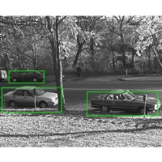
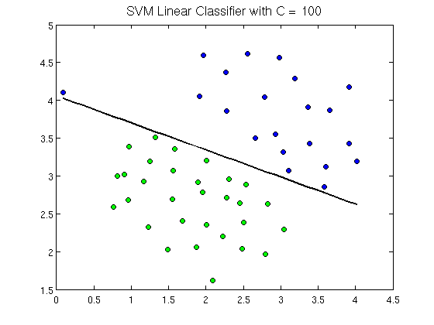
Data Analysis
Then | Now
For large datasets, it is usually the case that relatively small samples must be used. Customer studies are often based on surveys. Study results are frequently on aggregate data. Data numeric or text. | Characterized by analytics on the population of data, though some datasets are still so big that sampling must be used. Customer studies based on behavior, and at extreme detail. Wide scale use of relationships – e.g. social networks. Data numeric, text, speech, image.
Graphs, networks, and paths
Relationships Visualized – Recommender Systems
Visual Pattern Recognition
Machine Learning
www.ri.cmu.edu
openclassroom.stanford.edu

Slide 64
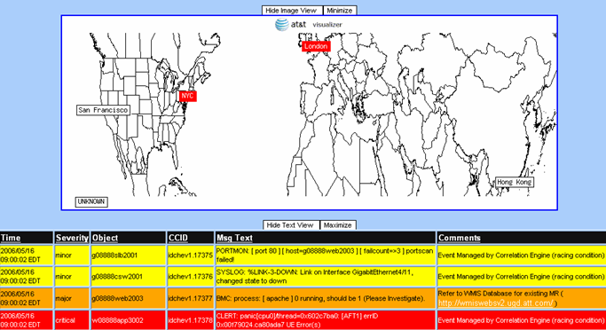



Information Visualization “Human in the loop”
Then | Now
Largely descriptive and embedded in reports or dashboards. Aggregate measures most common, and created from a fairly restricted set of models characterized by statistical system. | Characterized by scale, interactivity, and integration. Usually real time with immediate drill down facilities. Often with powerful new models to express detail Sometimes derived from gaming systems.
Graphs, networks, and paths
Word Clouds
Relationships Visualized – Recommender Systems
VizGems – Transparency, Integration, Control Through Visualization

Slide 65

Driving Technology
Then | Now
Innovation within Data Management over a period of 30 years largely controlled by Relational Model, with some exceptions such as OODB | Dynamic research in new tools embodying technologies such as NoSQL, Map/Reduce, DSMS, DSW, R, et al.. Much driven by large web companies. Some basic technologies, e.g. compression, become much more important.
Data Manaaement Systems
Interactive Visualization & Data Integration
DSWS
Data Stream Warehouse Systems
DSMS
DS1
DS2
DS3
DSW
Graph Analysis at Large Scale
Image Source Page: http://www.testically.org/wp-content/uploads/2011/05/

Slide 66
Organizing for Innovation - Maturity
Then | Now
Classical research or exploratory development teams create new products, often in large teams with significant timelines. Careful attention is paid to decision gates to prevent runaway costs. Due to costs, decisions often top down. | Small, elite teams create prototypes of potential products quickly, trial the prototypes, and, when successful, present for funding to go to market. Go to trial, very quick. Classical research provides technology base to prototyping teams, and partners with them.
Incubation and Production
Data OA&M
Data Governance

Slide 67
Data Governance
Then | Now
Data governance is typically the responsibility of the IT department, who, in cooperation with various stakeholders, develops policy, along with the processes to implement the policy. | Driven by the broader use models of big data, and the significance of non-IT stakeholders, policy should be done at a higher level. Protection of SPI data a constant problem. Transparency of use, and integrity of data are concerns. In general, the level of risk associated with the creation, curation, management, and use of data is considerably higher, hence governance is an even more critical task. The state of the art in this area is not yet mature.

Slide 68
Big Data Governance (Soares, “Big Data Governance: An Emerging Imperative” pp 4-6)
Big Data Governance: Policy => Process for issues such as:
Privacy
Retention
Use
Security
Measurement
Audit / Log
Big Data Governance Definition: Big data governance is part of a broader information governance program that formulates policy relating to the optimization, privacy, and monetization of big data by aligning the objectives of multiple functions.
Part of a broader information governance program
About policy formation
Must be optimized
Privacy is important
Must be monitized
! Exposes natural tensions across functions

Slide 69
Data Governance
Policy => Process => Practice
Data Modeling
Data Quality
Risk & Compliance
Retention
Privacy and Security
Chief Data Officer or CIO? Chief Privacy Officer, Chief Security Officer, …

Slide 70

Data Governance Maturity
http://ibmdatamag.com/2012/04/big-data-governance-a-framework-to-assess-maturity/

Slide 71
Operations, Administration, & Maintenance (OA&M)
Then | Now
Much of the infrastructure supporting OA&M for data intensive systems have been embedded in successive generations of data base management systems, and assumes properties such as ACID. | The latest generation of data base and data stream tools are often not mature enough to have full featured OA&M capability, and properties such as ACID are often weakened in Big Data Systems. This has resulted in a variety of ad-hoc techniques across much of the data pipeline. High levels of integration have also complicated these functions.

Slide 72
Meta Challenges
Then | Now
Significant systems containing sensitive data are not easily accessed. Complex semantics and poor integrity often exist, but impact is hidden because data is relatively closed. Integration, outside of joins, uncommon at scale. | Protection of SPI data a constant problem. Transparency of use, integrity of data a concern. Open data provides much more opportunity for interesting new apps from integration, and semantic confusion. Integration complex.
Security
Privacy
Integrity
Semantics
Integration

Slide 73
Data Privacy
Privacy Policy
http://www.att.com/gen/privacy-policy?pid=2506
http://info.yahoo.com/privacy/us/yahoo/mail/ymail/details.html
Third Parties
http://www.jpmorgan.com/pages/cookies
Review Boards
Opt in/ Opt out
Balkanization
Standards
http://www.hhs.gov/ocr/privacy/hipaa/understanding/summary/index.html
Aggregation, Anonymization, Authentication.
Location – Real Time Privacy
http://www.google.com/intl/en/policies/privacy/

Slide 74
Anonimyzation
Data anonymization is the use of one or more techniques designed to make it impossible -- or at least more difficult -- to identify a particular individual from stored data related to them. (WhatIs.com)
Personally Identifiable Information (PII)
Age, Zipcode, Gender == 87% Uniquely Identified in U.S.
Some Anonymization Techniques:
Encryption
Aggregation
Hashing
Field Deletion
Addition of Noise
K-Anonymization and related techniques.

Slide 75
Data Security
Standards: PCI, HIPAA, FISMA
https://www.pcisecuritystandards.org/security_standards/index.php
http://www.hhs.gov/ocr/privacy/hipaa/administrative/securityrule/security101.pdf
Encryption
Logs / Audits
Cloud

Slide 76
Data Quality and Integrity
Then | Now
Much of the burden of quality and integrity lies in the fact that the ACID properties and input rules of transactional systems are strictly enforced. There is a very rich technical ecosystem that has been built around integrity and is made available in most mature data management systems. | In many systems, at the volume, velocity, latency, and complexity expected, the levels of correctness required of transactional systems are neither possible nor necessary. Analytic techniques must take these changes into account. Given the very diverse nature of potential data sources, and consequent reduction in control over the data, this becomes a very challenging problem.

Slide 77
Big Data Quality
Dimension
Frequency
Variety
Traditional
Largely Batch
Structured
Big Data
Batch & RT - Streams
[ _ ,Semi,Un]Structured
Confidence Levels
Timing
Location of Analysis
ACID, Correct & Consistent
Prior to DW Load
Data Moves to Analysis
Good enough for analysis
Engines may move to data
Sunil Soares, Big Data Governance: An Emerging Imperative

Slide 78
Some Commercial Big Data Platforms (Soares)

Slide 79

IBM Platform (Soares)

Slide 80

Oracle big data platform (Soares)

Slide 81

SAP big data platform (Soares)

Slide 82



Lessons from Experience
It’s All About the Data: Organic & Inorganic
Goal: Fundamental Process & Product Change
Concentrate on Framing the Right Questions.
Ask Big Questions
Strategy
Technology
Big Data Lessons
EcoSystem
Multidimensional Expertise is Essential
The Nature of Analytics has Changed
There are tradeoffs: e.g. Speed vs. Accuracy
Think Steams of Data
Do Not Ignore the Broader World: Data, Technology, Practices
Customer Focus: Make Heroes of Your Partners
RESEARCH – INCUBATION - PRODUCTION
Notes:
http://www.clker.com/cliparts/G/8/c/L/T/g/plant-growth-md.png

Slide 83
Some Lessons Learned
Technology
Multidimensional technical expertise is essential:
Network – Computing – Data Analysis – Visualization - Domains
The Nature of analytics has changed:
parallel, streams, predictive, geospatial
Data Feed management can scale linearly. That is really bad
Tradeoffs:
Optimize Speed vs. Accuracy
Depth & Volatility: Rules vs. Differences
Information Content: Weak & Strong Signals

Slide 84

Some Lessons Learned Strategy
A defendable niche provides time to mature – scale
It’s all about the data – organic and inorganic
The Goal is to Enable Fundamental Process and Product Changes
Ask Big Questions: e.g. “Can an IP Network Run Itself?”
http://www.indiebloggers.org/tactics-of-a-chess-game.html

Slide 85

Some Lessons Learned Ecosystem
Few corporations can ignore the broader technology world, and none should.
Sometimes the most effective way to impress management is to go outside – e.g. Netflix, Idol
Customer Focus - Choose your partners well, and make them heroes
Components of an ecosystemThe above image of an ecosystem includes the following components some of ...www.westone.wa.gov.au

Slide 86
ASK YOURSELF! Before you jump
Big Data Starter Kit – Prior to Projects
Big Data Project I – Prior to Project Approval
Big Data Project II – After Approval
Big Data Organization I
Big Data Streaming I

Slide 87
ASK YOURSELF! Big Data Starter Kit (Prior to projects)
Is Big Data the right thing for my organization now?
Will Data Analysis or Data Engineering be first priority in success of planned projects?
Are my users ready for this?
Do I have appropriate leadership for such an effort?
Can I manage scale, without scale managing me?

Slide 88
ASK YOURSELF! Big Data Starter Kit (Prior to projects)
Is Big Data the right thing for my organization now?
If yes, what are the first two opportunities?
If no, are you missing something?
Will Data Analysis or Data Engineering be first priority in success of planned projects?
If Data Engineering, look into light weight innovation and incubation technology to reduce cost and risk, while leveraging technical staff.
If Data Analysis, ensure that leverage is based on analytical/visualization tools.
If “don’t know”, get help to figure it out. This is important!
Are my users ready for this?
Three user types: risk averse, risk unaware, risk controlled.
Do I have appropriate leadership for such an effort?
Leadership, Technical, Managerial, Governance.
Can I manage scale, without scale managing me?
Standards are necessary for production, but could guarantee failure if inappropriately applied.

Slide 89
ASK YOURSELF! Big Data Project I (Prior to approval of project)
What will change if this project succeeds?
Does this need to use “big data” technology?
Can I form an appropriate team to create the application?
Can I form an appropriate structure to deploy and operate the resultant application?
Who is responsible to have appropriate user processes in place?
How will results be delivered? To Whom/What?

Slide 90
ASK YOURSELF! Big Data Project I (Prior to approval of project)
What will change if this project succeeds?
If no good answer, do not initiate
Ideally it should create some process or product change.
Does this need to use “big data” technology?
Can it be done with Warehouse/DataMart or other more classical technologies. If not, why not.
Can I form an appropriate team to create the application?
For example, access to domain expert, user champion, analytic expertise, visualization expertise, software/data management expertise, meta (e.g. security, compliance) expertise.
Can I form an appropriate structure to deploy and operate the resultant application?
Many don’t even know what this means.
Who is responsible to have appropriate user processes in place?
If no really good answer, you may get successful software with failing project.
How will results be delivered? To Whom/What?
If only “dashboard” why big data? If “Whom” what actions will result, on what timeframe? If “What”, you need to think of operational controls.

Slide 91
ASK YOURSELF! Big Data Project II (After you have decided to do the project)
Have I framed the right questions?
Do I have, or can I get, the data to address these questions?
Is this a significant data integration project?
Do I have an appropriate team to create the application?
Do I have appropriate structure to deploy and operate the resultant application?

Slide 92
ASK YOURSELF! Big Data Project II (After you have decided to do the project)
Have I framed the right questions?
If no good answer (or not sure), stop!
Do I have, or can I get, the data to address these questions?
If no, why not and what should be done about it.
Is this a significant data integration project
That is, is it dominated by data complexity as well as 3 Vs.
If yes, data and systems engineering will be required (e.g. feed control and synchronization).
Do I have an appropriate team to create the application?
If not, when?
Do I have appropriate structure to deploy and operate the resultant application?
Many, if not most, projects delay this, at their peril.
Failure here can make a valuable application into a cost sink.

Slide 93
ASK YOURSELF! Big Data Organization I
Does my organization have clear data governance policies in place for big data?
What skills are needed, do we have them, and how are they organized?
Do we understand Deployment and Operations, and can we use them?
Do I need to create Incubation Groups, Sandboxes, other infrastructure. E.g. Leverage people with capital.
Can we answer the meta questions for likely projects?

Slide 94
ASK YOURSELF! Big Data Organization I
Does my organization have clear data governance policies in place for big data?
Policy, Process, Practice
What skills are needed, do we have them, and how are they organized?
Not only technical skills, but managerial and leadership skills.
Do we understand Deployment and Operations, and can we use them?
The point isn’t the buzzwords, but making sure the functions can be executed with high quality, at reasonable cost.
Do I need to create Incubation Groups, Sandboxes, other infrastructure. E.g. Leverage people with capital.
In my experience this is the difference between long term success and frustration.
Not required for the first project, but needed by the second.
Can we answer the meta questions for likely projects?
E.g. : Should we create a processes for: Cost/Benefit, Risk, Compliance, Security, Privacy (does it cross borders), …

Slide 95
ASK YOURSELF! Big Data Streaming I
Does my organization have clear data governance policies in place for streaming data?
What skills are needed, do we have them, and how are they organized?
Do I have critical applications that are real time, or near real time?
How will my network support streaming applications? Perhaps micro batch instead?
Can we answer the meta questions for any project?

Slide 96
ASK YOURSELF! Big Data Streaming I
Does my organization have clear data governance policies in place for streaming data?
Policy, Process, Practice
What skills are needed, do we have them, and how are they organized?
Not only technical
Understand that this will involve synchronization of multiple datasets.
Do I have critical applications that are real time, or near real time?
If not, why would I do this?
How will my network support streaming applications? Perhaps micro batch instead?
Operations of a stream based application creates timing, quality, and system design issues that have to be nailed.
Can we answer the meta questions for any project?
E.g. : Should we create processes for: Cost/Benefit, Risk, Security, Privacy (does it cross borders), …

Slide 97

Thank You

